Slide 1
Maternal and fetal vital signals
Fetal Doppler
Fetal ECG
Maternal vital signs
18.2.2 Describe maternal and foetal vital signals
Unit C 18.2 Maintaining Gynaecology and Obstetrics equipment
Module 279 19 C Medical Instrumentation II
©
dr. Chris R. Mol, BME, NORTEC, 2015

Slide 2
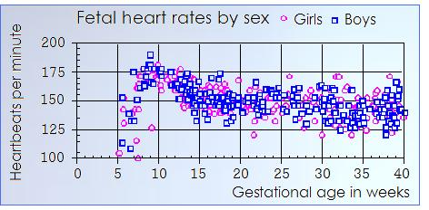
Fetal Heart Rate
Fetal heart rate (FHR) is an important parameter that can be monitored during pregnancy and labor.
During pregnancy, the fetal heart rate is significant in determining the fetal well-being, fetal development and the presence or absence of any congenital heart disease.
During labor it gives an indication for fetal condition and distress.
FHR is measurable from week 5 onwards. It quickly rises to over 170 beats/minute in week 9 and then drops back to the ‘normal’ range of 120-160 beats/minute.
It Is not a good predictor for fetal gender….
©
Vital Signs
dr. Chris R. Mol, BME, NORTEC, 2015

Slide 3
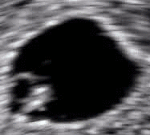
Fetal heart rate measurement
Fetal heart rate can be monitored with various techniques:
Fetoscopy
Ultrasound imaging; Ultrasound Doppler technique
Fetal ECG measured with external electrodes
Fetal ECG measured with (direct) fetal electrodes.
This equipment will be discussed in the coming lectures.
fetoscope
‘Endo-vaginal Ultrasound’ image showing an embryo with a length of 3.5mm in a gestational sac with a diameter of 11mm, corresponding to a gestational age of approximately 5 weeks and 5 days. The heart can be seen beating !
©
Vital Signs
dr. Chris R. Mol, BME, NORTEC, 2015

Slide 4
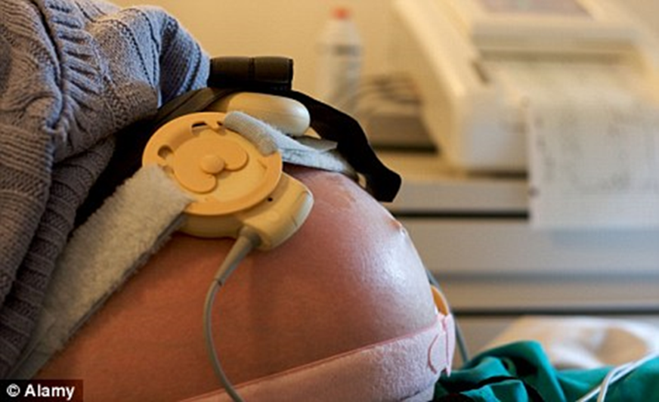
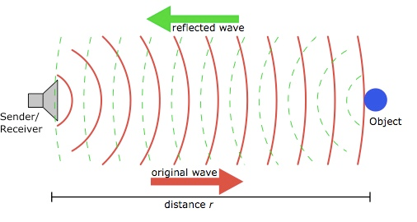
Fetal Doppler: Ultrasound Beam
Ultrasound imaging uses sound waves with a frequency above the human hearing range of 20Hz to 20kHz. The ultrasound used in fetal monitors is typically in the range 1 to 2 MHz.
An ultrasound transducer is strapped onto the mother’s abdomen using an elasticated belt. It transmits a beam of ultrasound into the body. A water based gel must be applied to the contact area between the transducer and the skin to get best performance. As human tissue is ~90% water, ultrasound travels well through the body.
The ultrasound beam is reflected off any tissue boundary layers in the beam profile (for example a change from soft tissue to muscle or bone, or from the walls of the fetal heart). The reflected signals are detected by the same transducer.
©
Vital Signs
dr. Chris R. Mol, BME, NORTEC, 2015

Slide 5
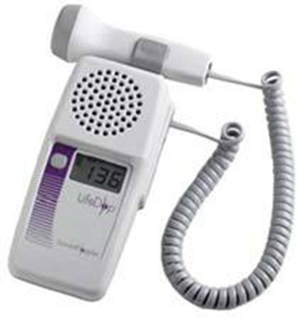
Fetal Doppler: Doppler shift
If ultrasound waves of a given frequency are reflected by a stationary reflector, the reflected waves have the same frequency as those transmitted.
If the reflecting body is moving, this movement causes a change in the ‘pitch’ (frequency) of the reflected signal. This is called a Doppler shift, named after the physicist Christian Doppler, who first described this in 1842.
In pregnancy, the ultrasound beam is directed towards the fetal heart, so that ultrasound waves are bounced off the fetal heart. The Doppler shifts associated with the movement of the fetal heart are interpreted by the system as heart beats.
handheld Doppler system
The Doppler shifts are analysed by the system and are translated into an audible signal. Although this sound is actually generated artificially from the Doppler shift, it is perceived by users as representing the actual fetal heart sounds.
False Doppler signals can be generated by reflections of the ultrasound beam against other moving structures in the ultra-sound beam, e.g. in the case of fetal or maternal movement or motion from the placenta or umbilical cord blood flow.
©
Vital Signs
dr. Chris R. Mol, BME, NORTEC, 2015

Slide 6
Fetal Doppler: Doppler Principle
The Doppler shift is a phenomenon whereby any movement between the source of a sound (or ultrasound) & the receiver of that sound, results in a change in pitch (or shift in frequency) of the sound.
If the reflector is moving towards the transmitter-receiver, the reflected frequency will be higher than the transmitted frequency.
This phenomenon can be heard, for example, when a train approaches a station with its whistle blowing. As the train moves towards you, the pitch of the whistle goes up (not to be confused with the volume which also goes up!). As it passes you & moves away, the pitch of the sound drops. The amount by which the pitch of the sound changes is directly
proportional to the speed of the train.
Another example of the Doppler principle in everyday life is an approaching/receding police car siren.
©
Foetal Heart Monitor
dr. Chris R. Mol, BME, NORTEC, 2015

Slide 7
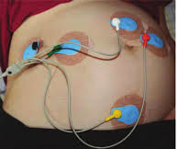
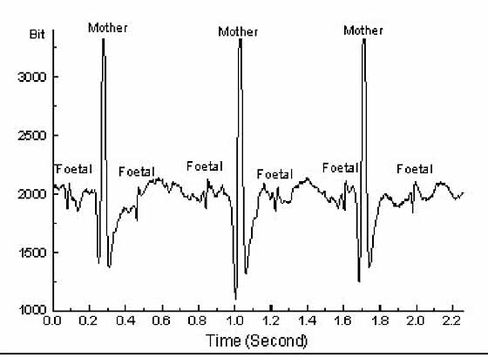
Fetal ECG via maternal surface electrodes
Surface electrodes are applied directly to the mother’s body, typically with adhesive silver-silver chloride electrodes. The surface electrode technique operates identically to a typical electrocardiogram, but with much more complex signal processing to reduce the probability of mistaking a maternal heart beat for a fetal heart beat.
The automatic separation of the two ECG’s is the topic of ongoing research….
The surface electrode approach to measuring the fetal heart rate has the advantages of being not invasive, being applicable at any time during pregnancy, and at very low cost.
However, they are subject to artefacts from the maternal heart beat, don’t work well with certain fetal positions and can’t resolve multiple fetal pregnancies.
©
Foetal Heart Monitor
dr. Chris R. Mol, BME, NORTEC, 2015

Slide 8
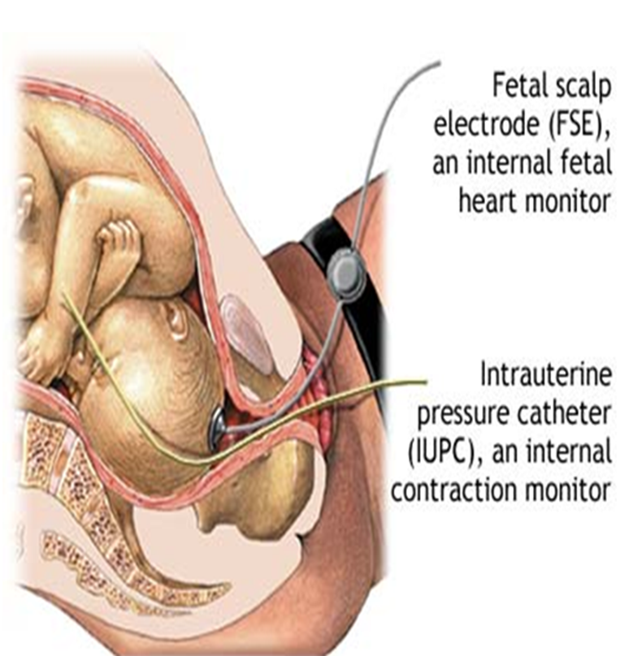
Fetal ECG via fetal scalp electrode
A fetal ECG can also be acquired as a part of monitoring during childbirth. This can be done by applying a Fetal Scalp Electrode (FSE) to the fetal head.
This involves a single electrode being passed through the woman's cervix and attached to the baby's scalp.
This approach is used only with high-risk patients, if labor is going very slowly or if the external fetal (Doppler) monitor is not detecting the fetal heart rate.
The amniotic sac must be broken to apply the electrode. The scalp electrode gives accurate fetal electrocardiograms. However, it is invasive, opens the amniotic sac for infection, and cannot be easily applied to multiple fetal pregnancies.
©
Foetal Heart Monitor
dr. Chris R. Mol, BME, NORTEC, 2015

Slide 9
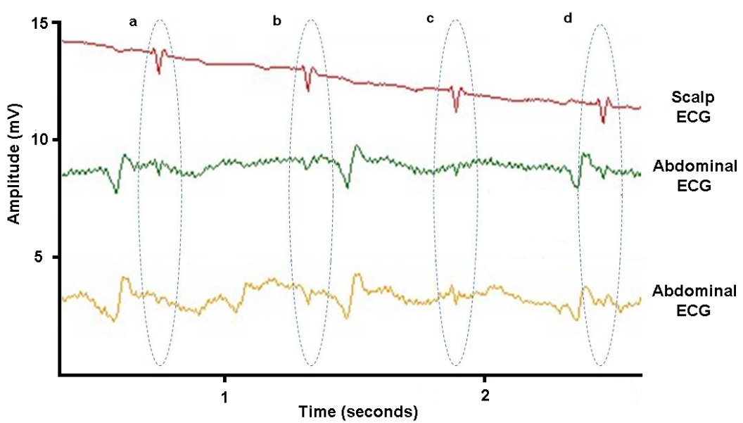
Fetal ECG: comparison between the two methods
©
Vital Signs
dr. Chris R. Mol, BME, NORTEC, 2015

Slide 10
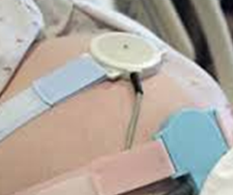
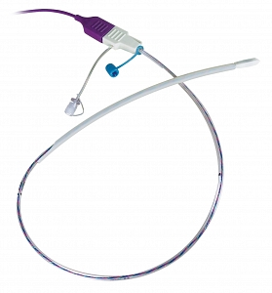
Maternal vital signs: contractions and intra-uterine pressure
These signals can be measured externally (toco) or internally via an intra-uterine pressure catheters (IUPC)
Uterine contractions are measured externally with a strain gage transducer or pressure sensor usually strapped with a belt around the abdomen positioned over the uterus. This senses changes in skin tension arising from the uterine muscular activity.
An intrauterine pressure catheter (IUPC) is used during labor induction to help measure the exact force of contractions during labor by taking into account contraction frequency, duration and strength. This is mainly of use for a doctor or midwife who wants to determine the amount of labor inducing medication to use.
IUPC
©
Vital Signs
dr. Chris R. Mol, BME, NORTEC, 2015

Slide 11
END
The creation of this presentation was supported by a grant from THET:
see https://www.thet.org/

